Slide 1
Conditional Generative Adversarial Network (C-GAN)

Slide 2
Introduction to the Conditional GAN - A General Framework for Pixel2Pixel Translation
Image-to-Image Translation with Conditional Adversarial Networks https://arxiv.org/pdf/1611.07004.pdf
Presentation (5 Minutes): https://www.youtube.com/watch?v=4Bm17KNOOqs
https://www.youtube.com/watch?v=B1bMMF8miN8

Slide 3
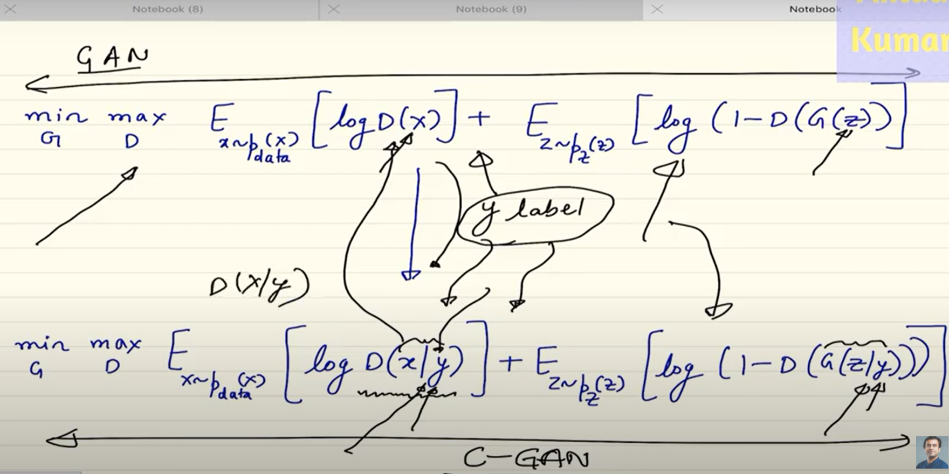
C-GAN
Like GANs

Slide 4
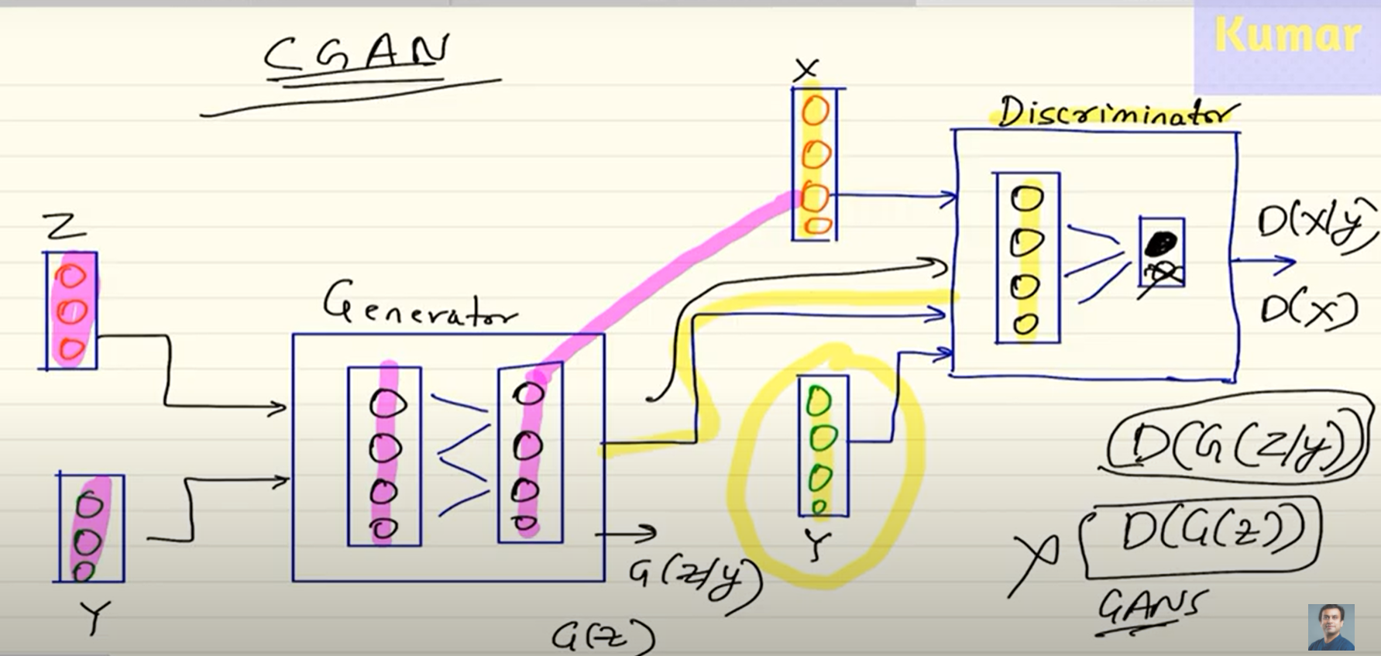
C-GANs VS. GANs
CGANs VS. GANs:

Slide 7
Deep Learning 27: (1) Generative Adversarial Network (GAN): Introduction and Back-Propagation
https://www.youtube.com/watch?v=RRTuumxm3CE&list=RDCMUCP9YJJ24w6g38VMVMm6Thtg&index=3
Deep Learning 28: (2) Generative Adversarial Network (GAN) : Loss Derivation from Scratch
https://www.youtube.com/watch?v=ZD7HtL1gook
Deep Learning 29: (3) Generative Adversarial Network (GAN) : Explanation of Loss Function
https://www.youtube.com/watch?v=pPlnx9D8WZQ&list=RDCMUCP9YJJ24w6g38VMVMm6Thtg&index=2

Slide 8
Deep Learning 30: (4) Generative Adversarial Network (GAN) : Optimization of Loss Function
https://www.youtube.com/watch?v=kkkvzx4Wbg4&list=RDCMUCP9YJJ24w6g38VMVMm6Thtg&index=11
Deep Learning 31: (5) Generative Adversarial Network (GAN) : Limitations of GANs
https://www.youtube.com/watch?v=ydGC0IvlCNs&list=RDCMUCP9YJJ24w6g38VMVMm6Thtg&index=8
Deep Learning 32: (6) Generative Adversarial Network (GAN) : TensorFlow code in Google Colab (Implementation)(MNIST_Fashion Dataset)(http://fashion-mnist.s3-website.eu-central-1.amazonaws.com/t10k-labels-idx1-ubyte.gz)
!wget http://fashion-mnist.s3-website.eu-central-1.amazonaws.com/train-images-idx3-ubyte.gz
!wget http://fashion-mnist.s3-website.eu-central-1.amazonaws.com/train-labels-idx1-ubyte.gz
!wget http://fashion-mnist.s3-website.eu-central-1.amazonaws.com/t10k-images-idx3-ubyte.gz
!wget http://fashion-mnist.s3-website.eu-central-1.amazonaws.com/t10k-labels-idx1-ubyte.gz
https://www.youtube.com/watch?v=ApgSpA-deBY&list=RDCMUCP9YJJ24w6g38VMVMm6Thtg&index=15

Slide 9
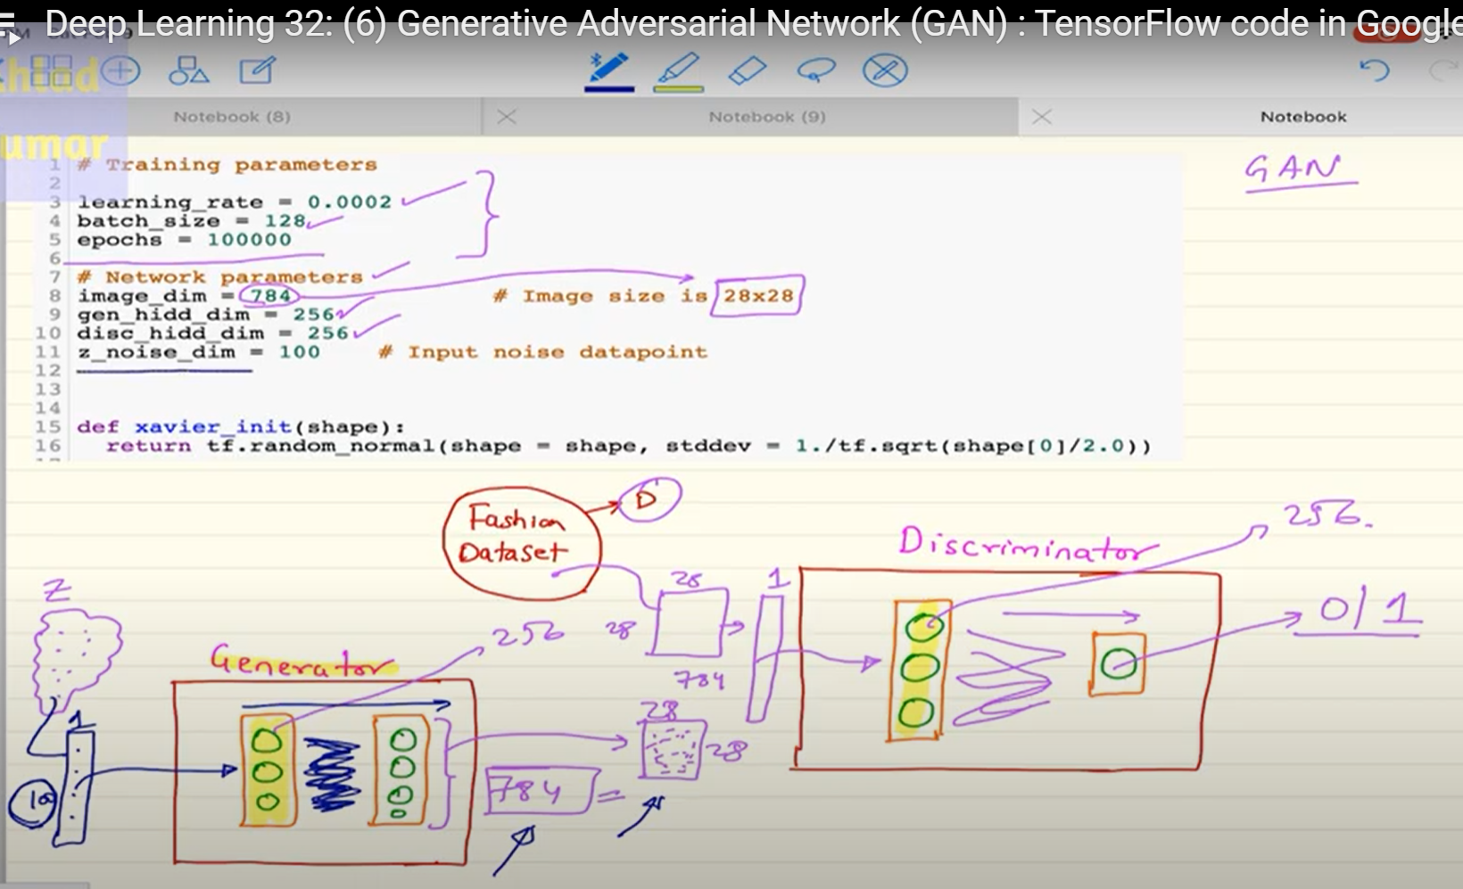
Code

Slide 10
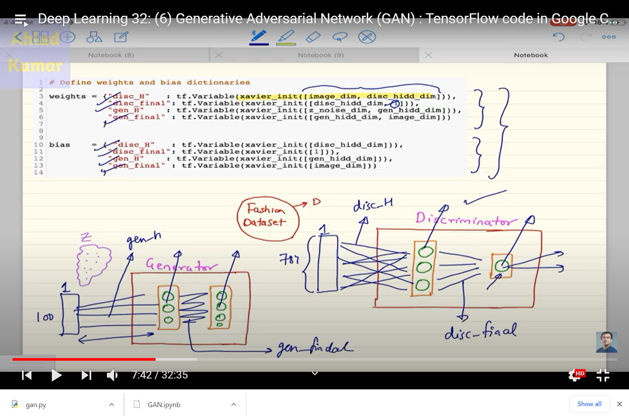
Code

Slide 11
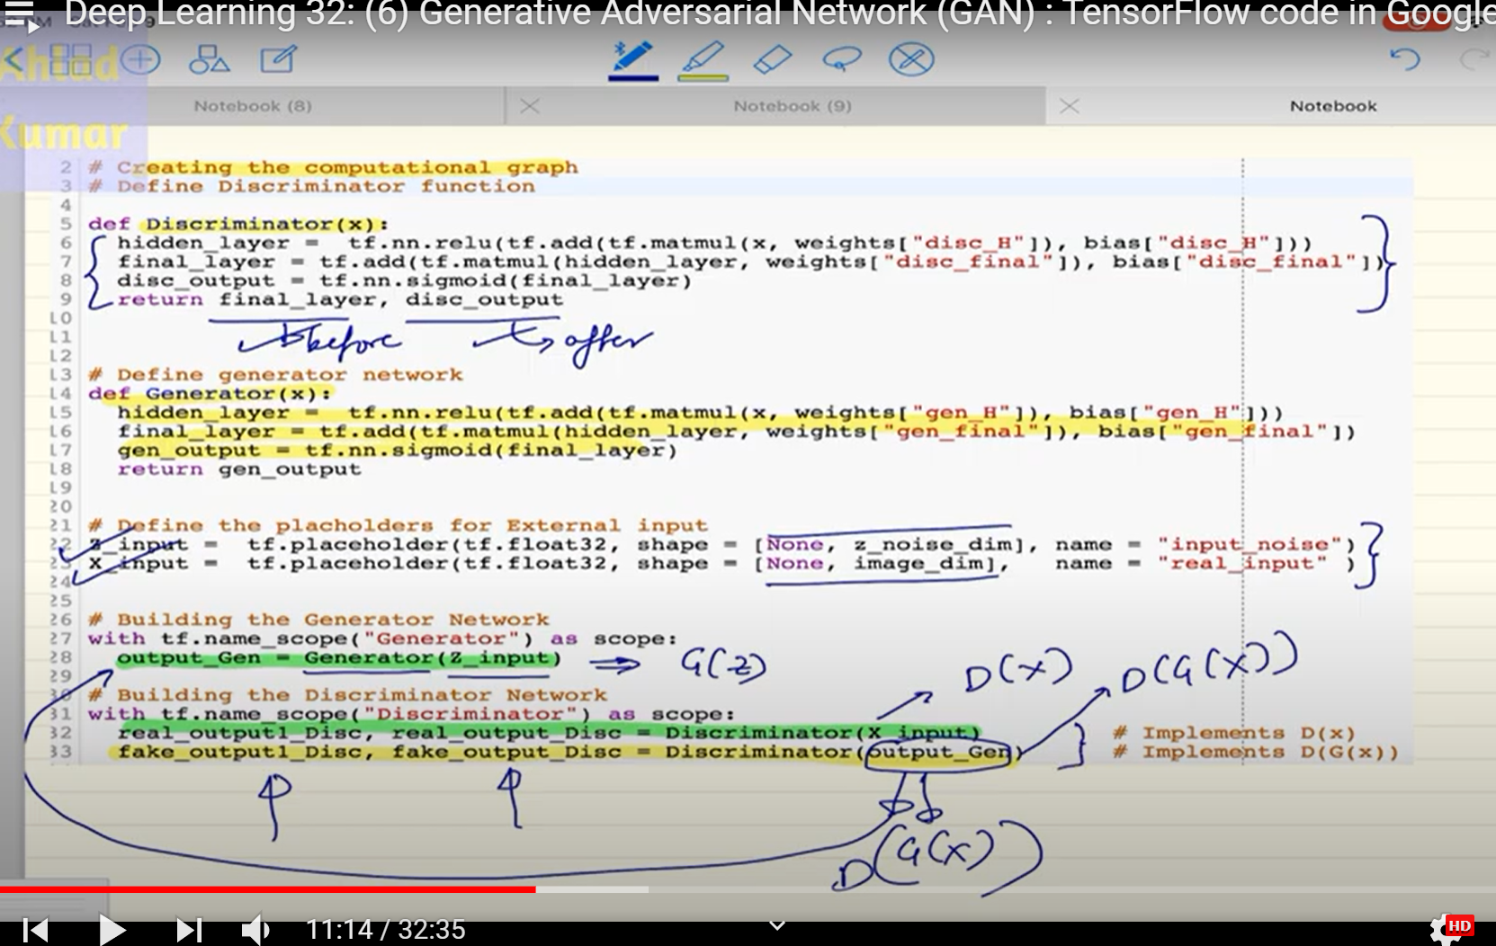
Code

Slide 12
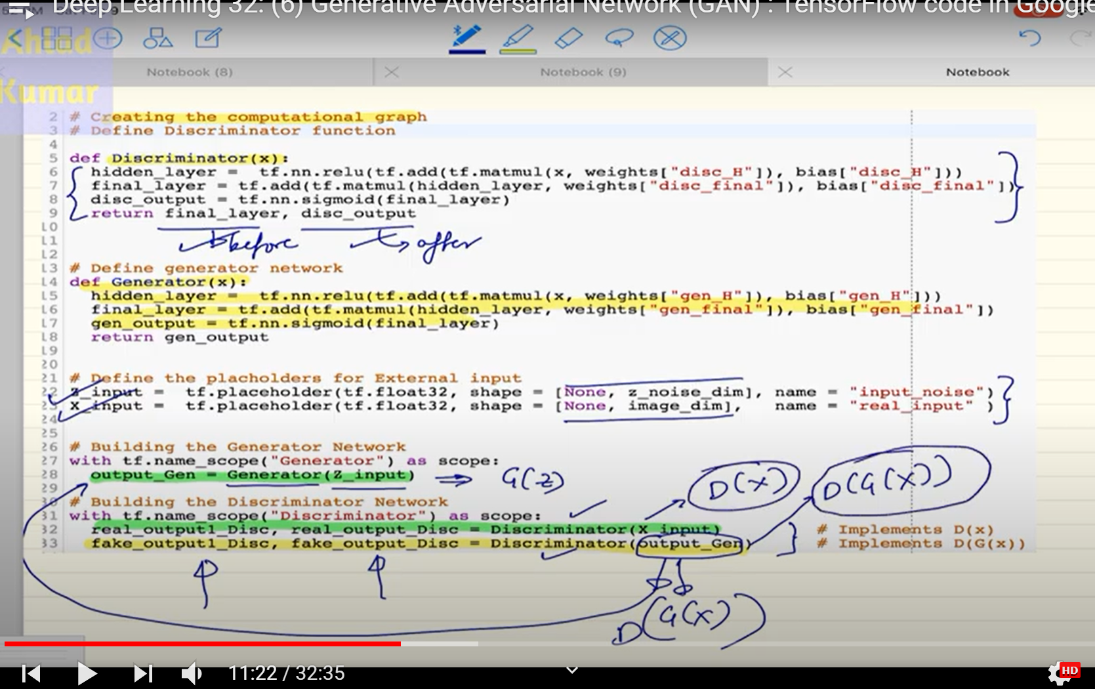
Why we have two returns for Discriminator output: D(x), D(G(z))
Code

Slide 13
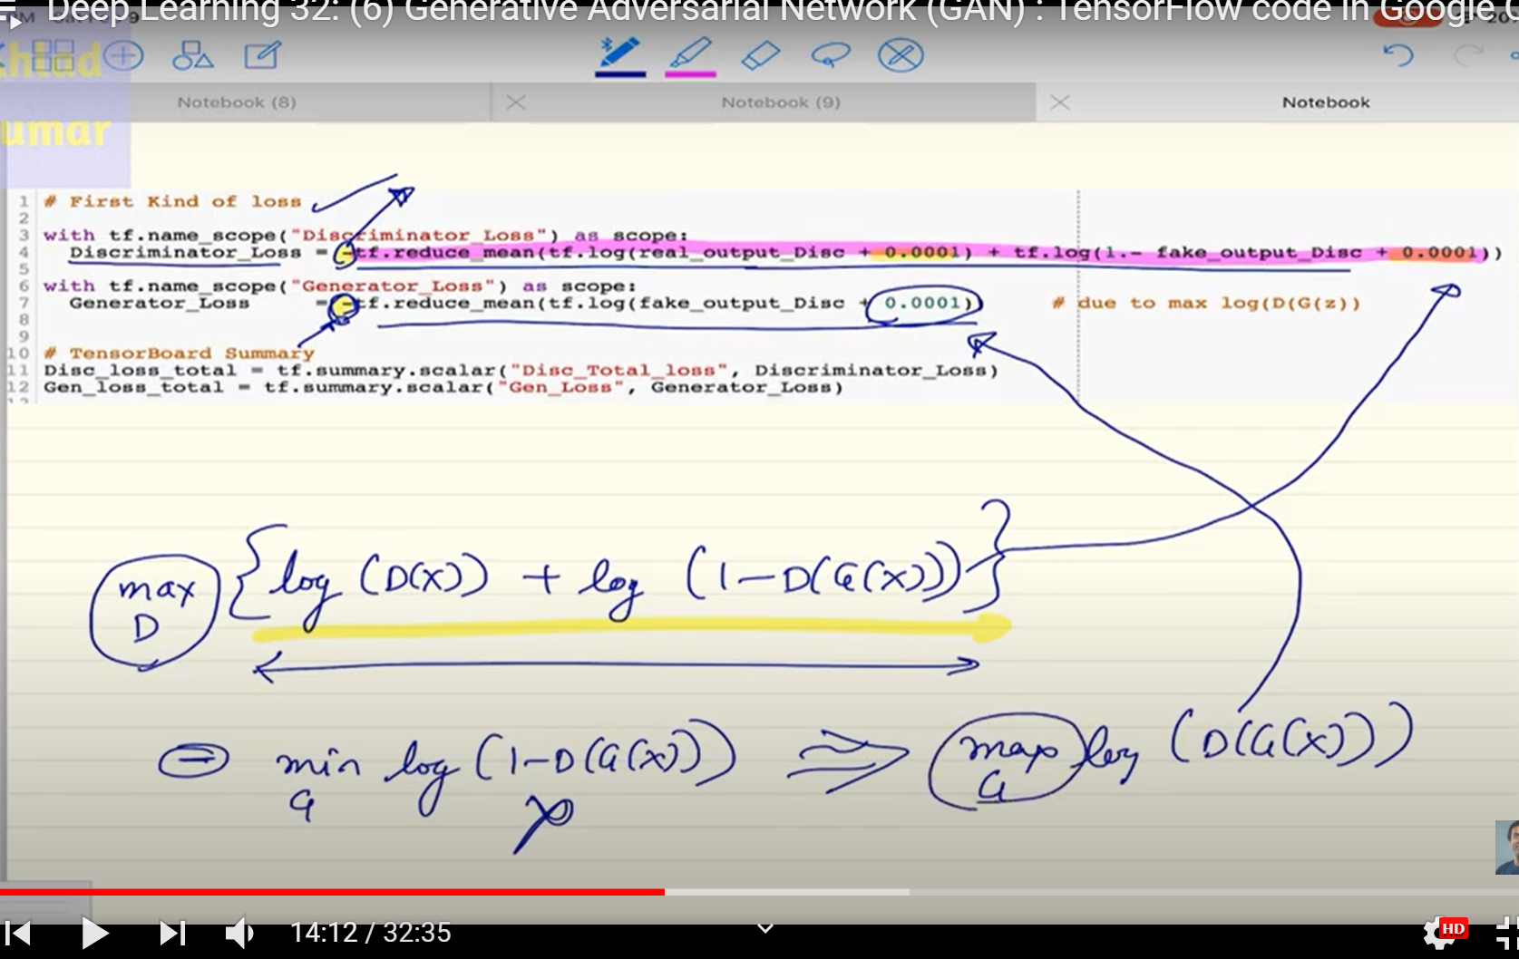
First Loss

Slide 14
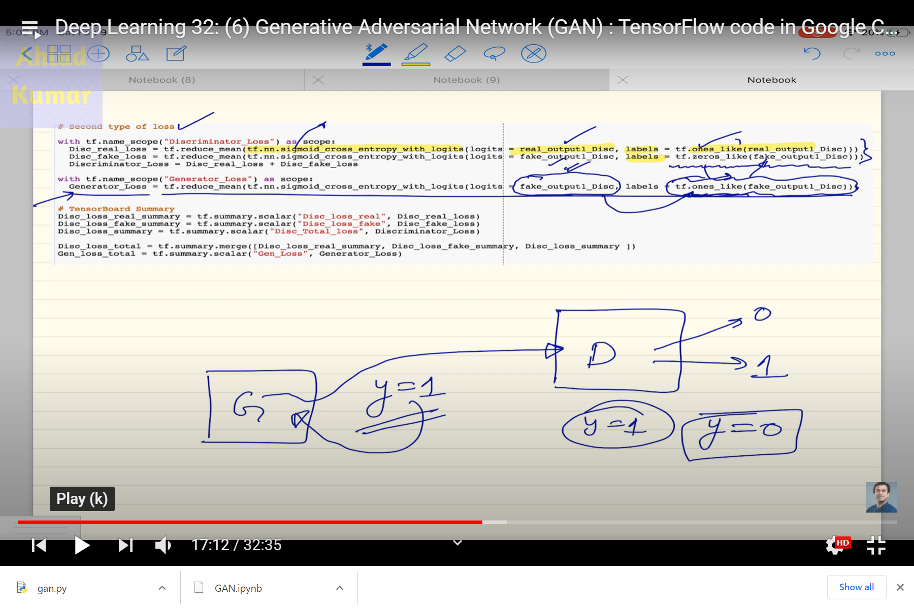
Second Type of Loss:

Slide 15
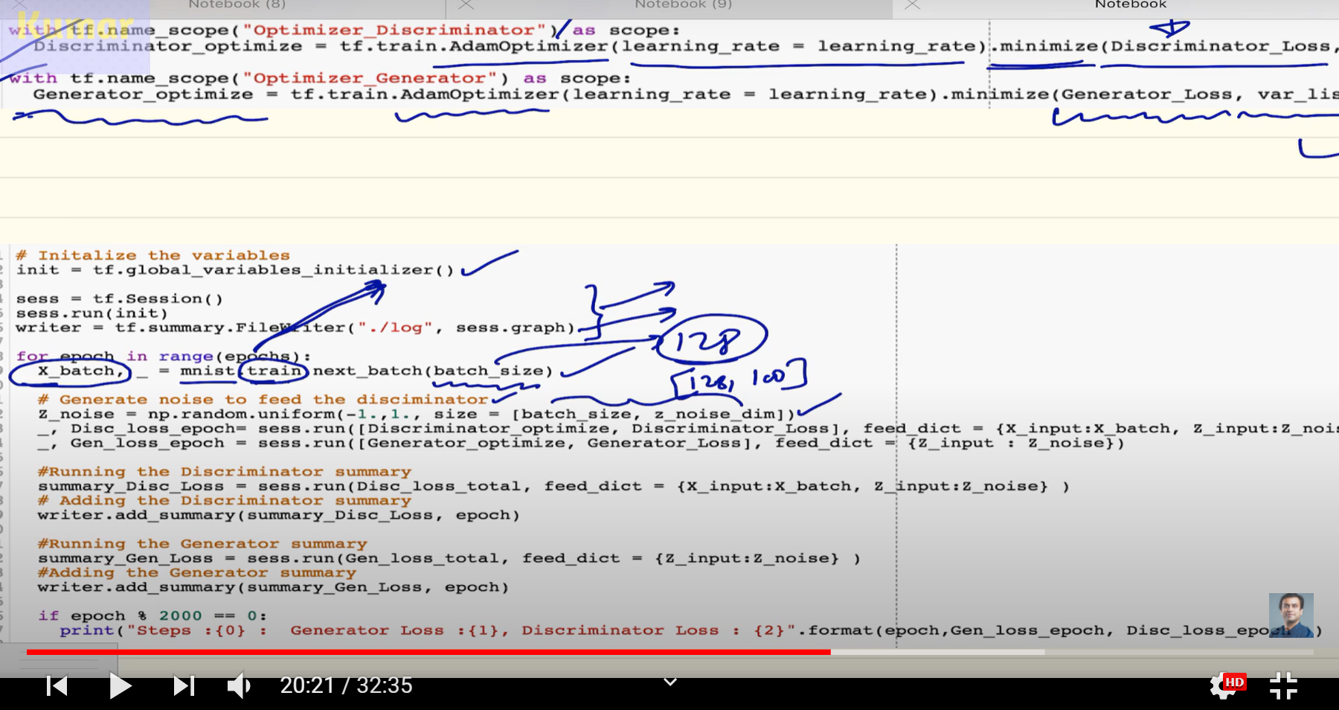
Scope

Slide 16
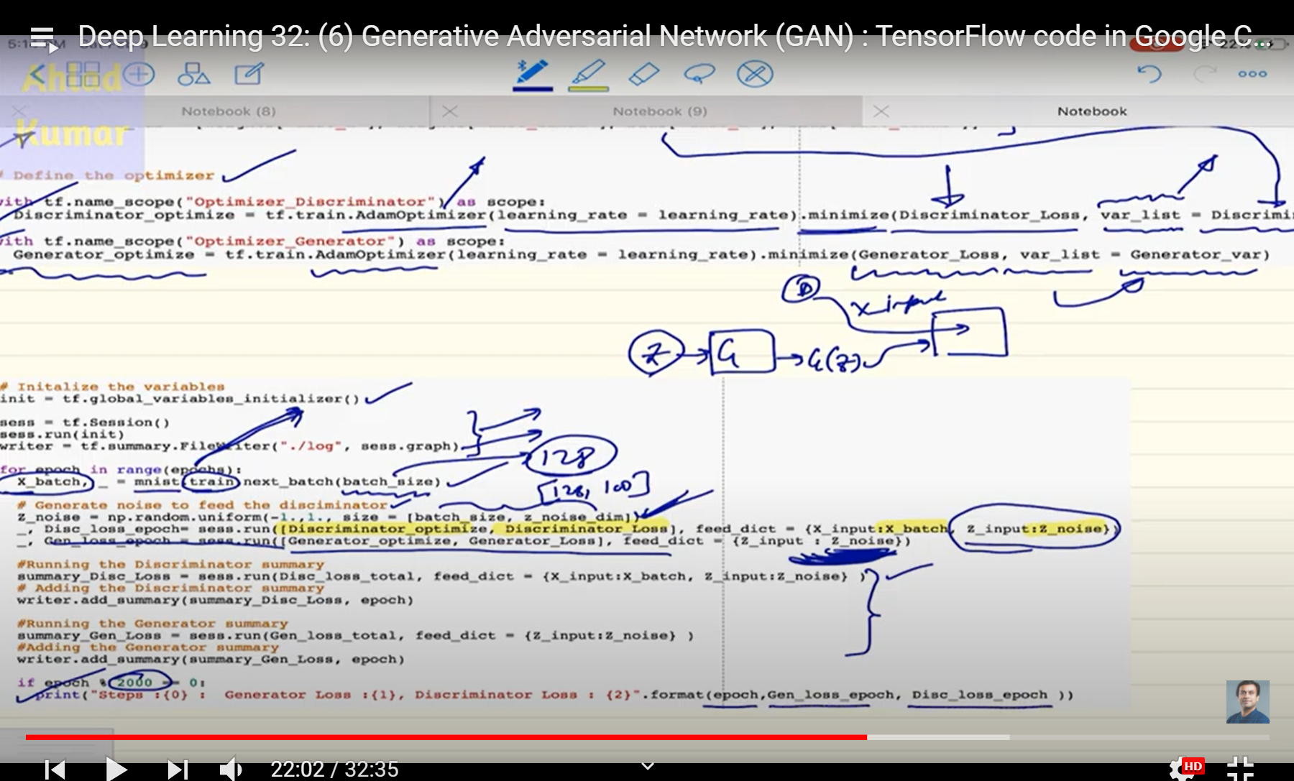
Epoch

Slide 17
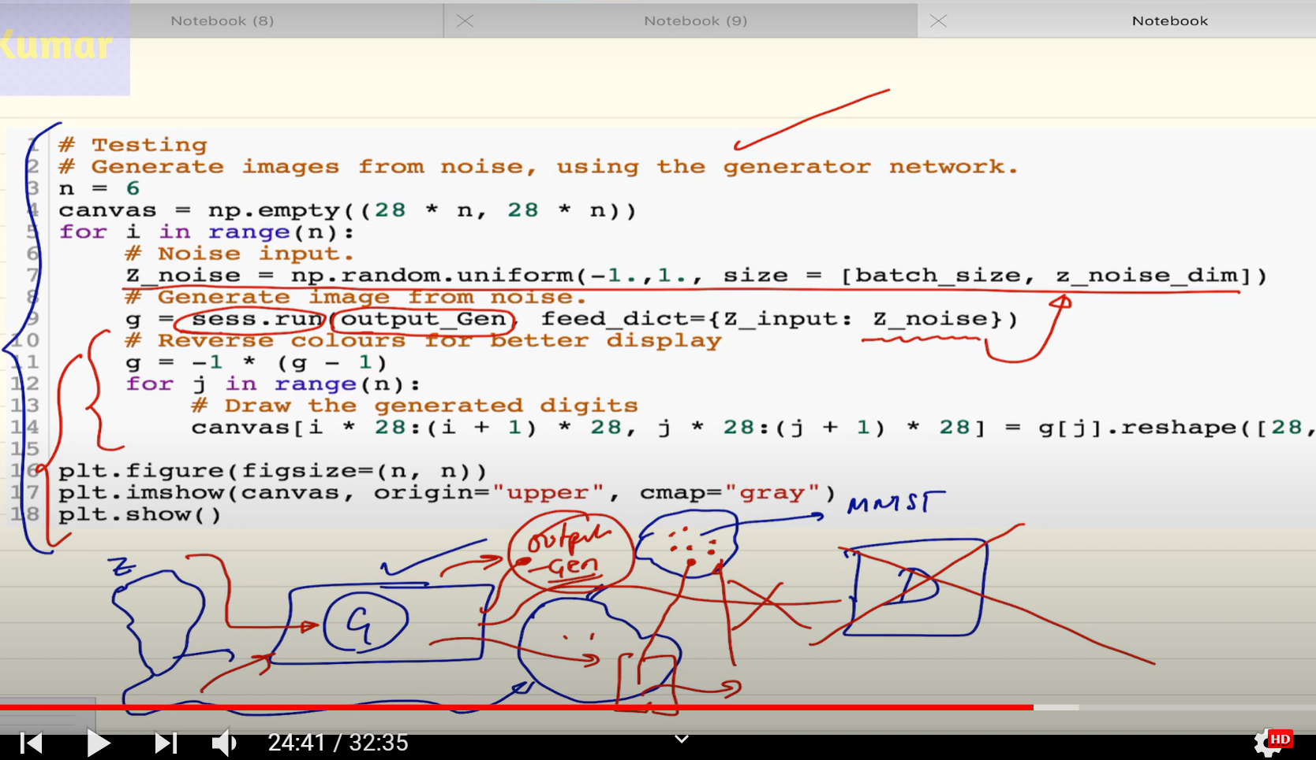
Testing phase and Generating:

Slide 18
Deep Learning 8: Running Tensorboard in Google Colaboratory for a simple Tensorflow based code
https://www.youtube.com/watch?v=laZntnRcFgI&list=RDCMUCP9YJJ24w6g38VMVMm6Thtg&index=19
1-download the log file in your desktop and put it into a file named tensorboard(for ex)
2-launch you anaconda prompt
3-activate your env (tensorflow should be installed in this env )
4-enter: cd Desktop
5-enter:tensorboard --logdir=tensorboard --port 6006
6-launch your web browser
7-enter: http://localhost:6006/

Slide 21
Deep Learning: Introduction to Wasserstein Generative Adversarial Network (WGAN)
https://www.youtube.com/watch?v=_z9bdayg8ZI

